Slide 1
VespAlert
23rd March 2022

Slide 2
MOdels
Segmentation
Learn polygon masks directly
Mask R-CNN
State-of-the-art: Detectron2
Bounding box object detection
Two stages:
Object detection
Classification
Transfer learning from COCO
State-of-the-art: YOLOv5

Slide 3
Step 1: MASK r-cnn

Slide 4
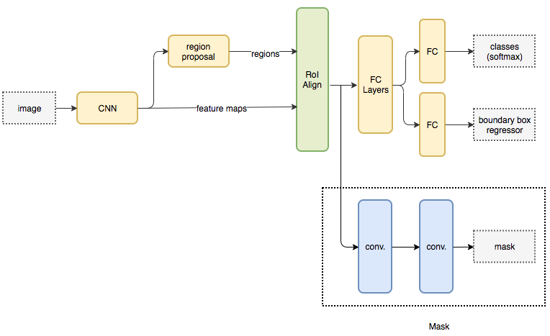
Mask r-cnn

Slide 5
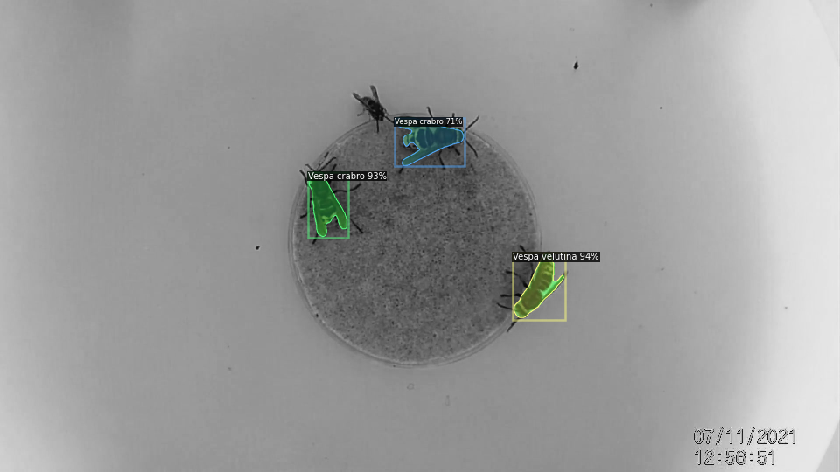
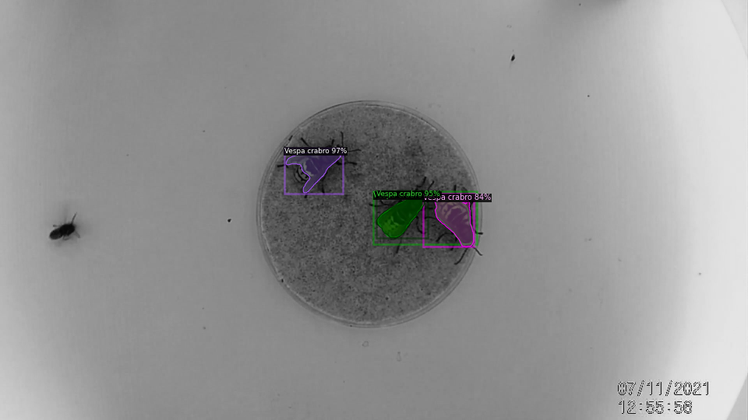
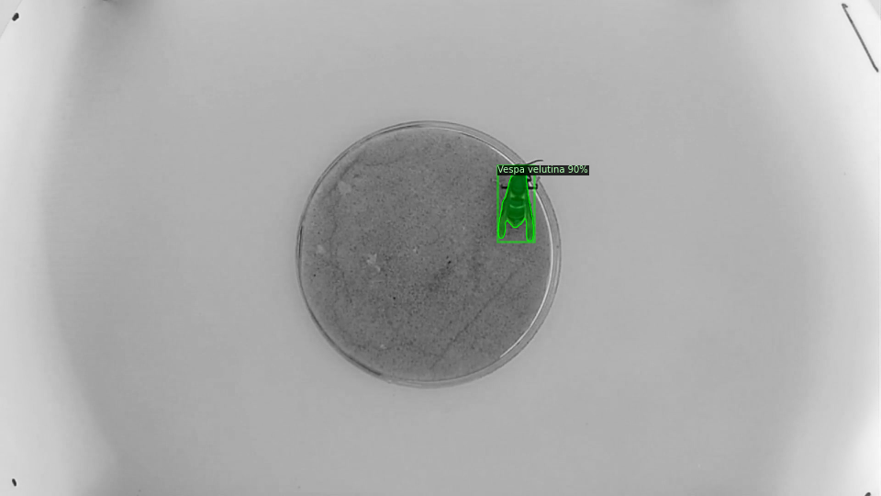
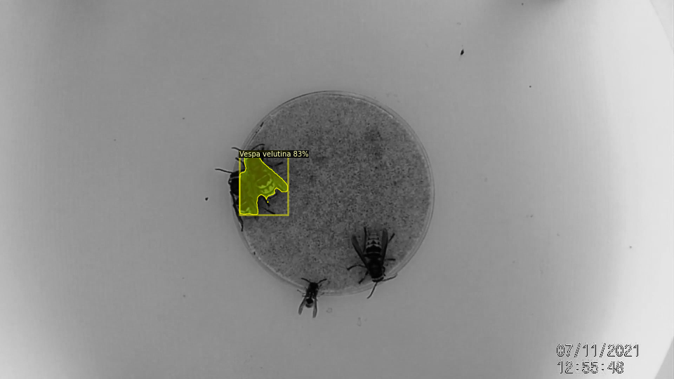
Mask r-cnn: results

Slide 6
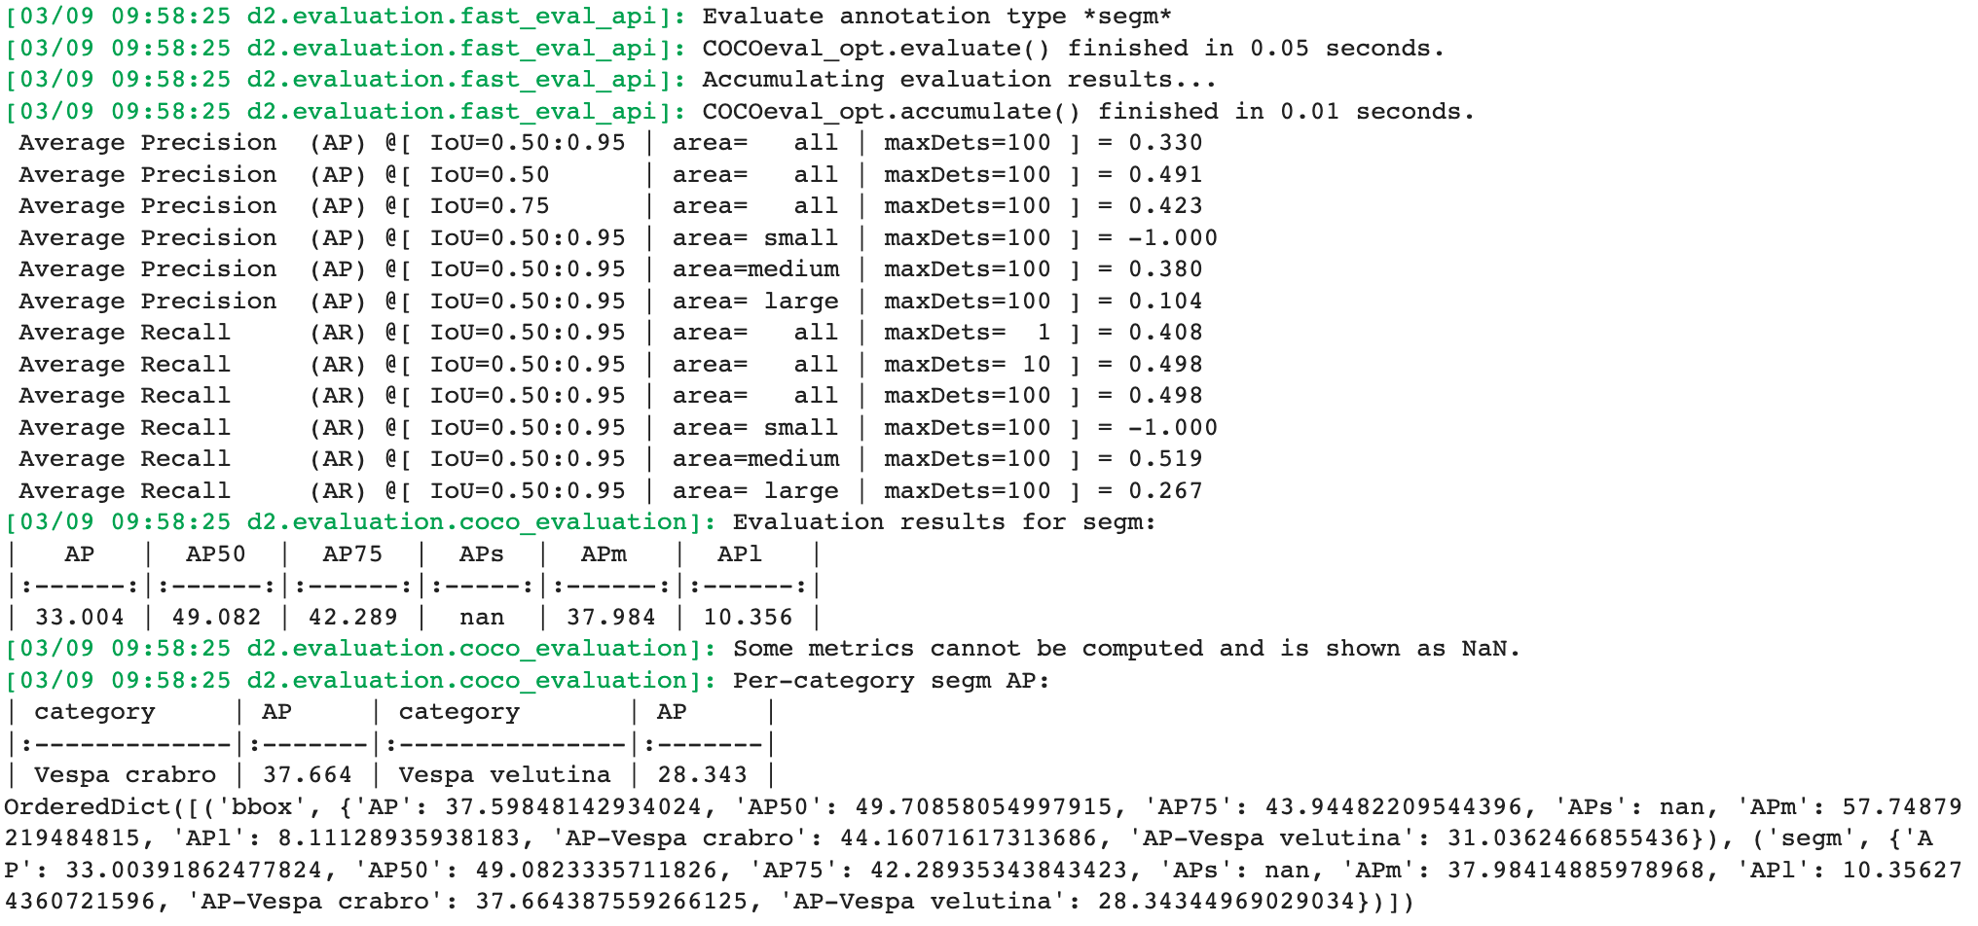
Mask r-cnn: results

Slide 7
Step 2: yolo

Slide 8
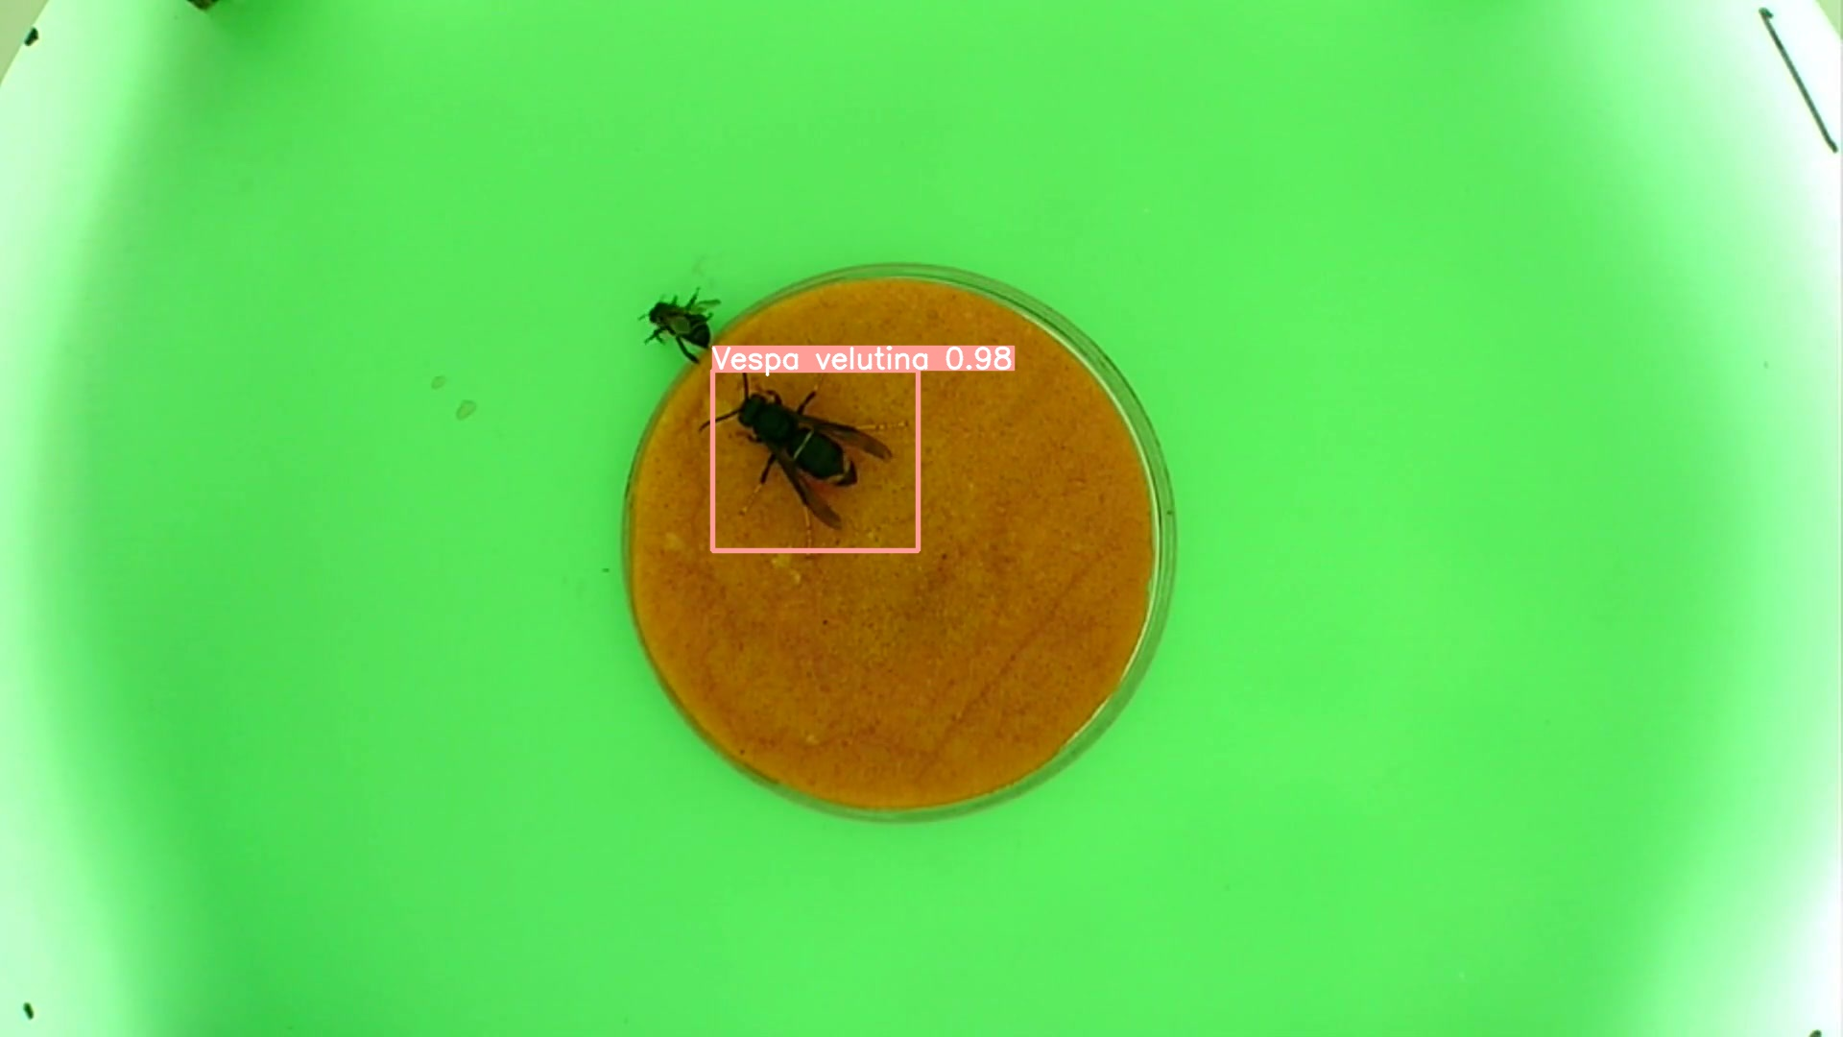
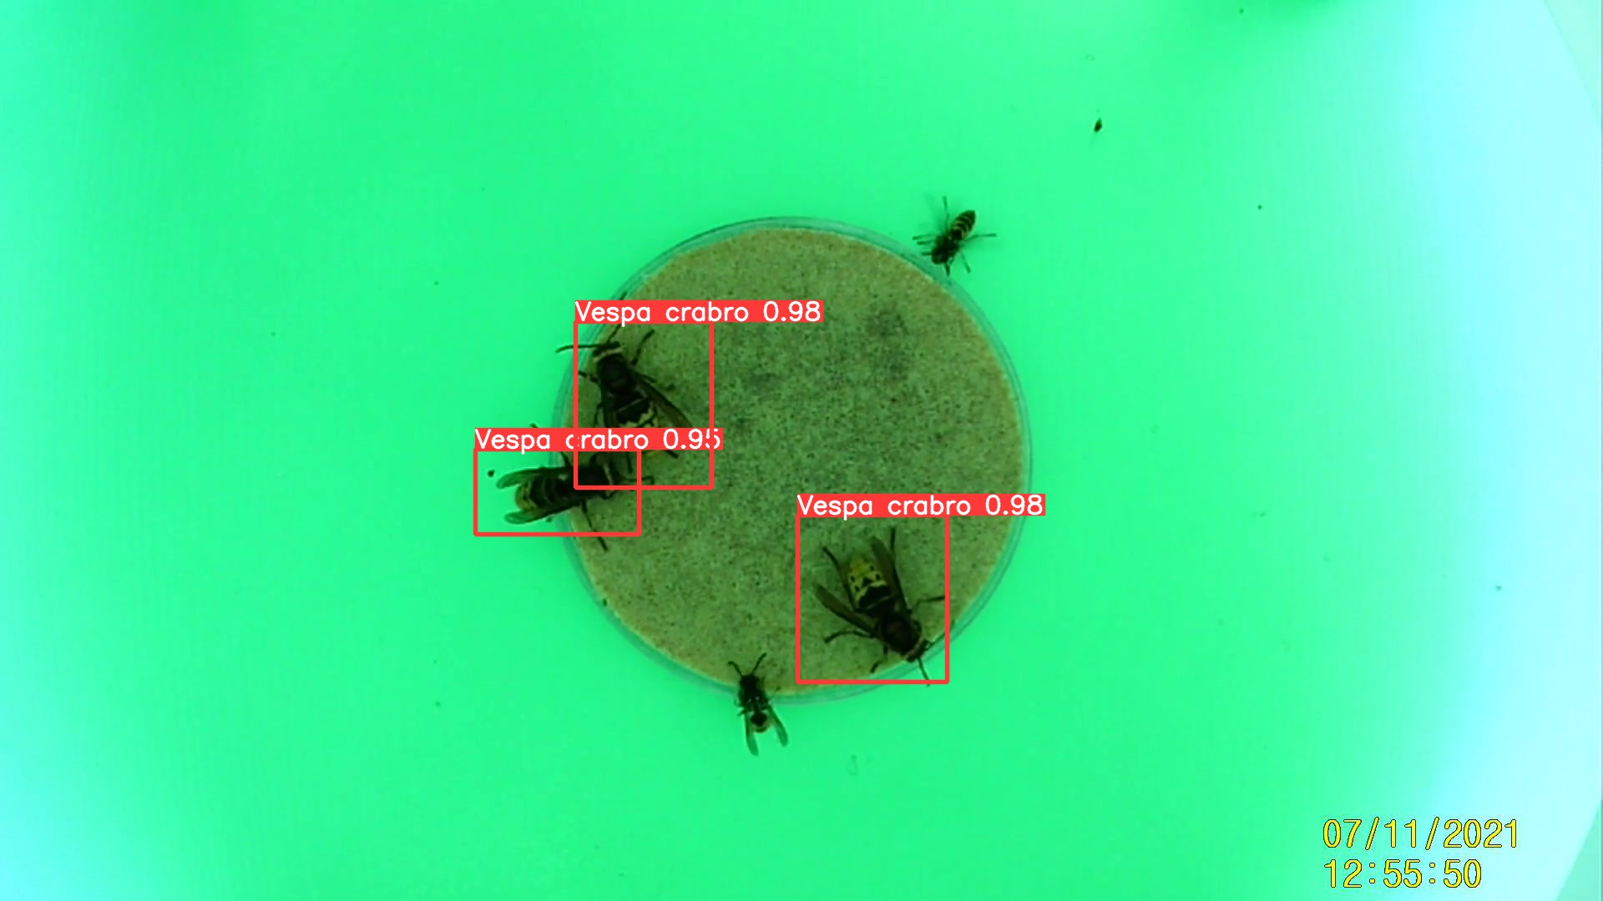
Yolo: results

Slide 9
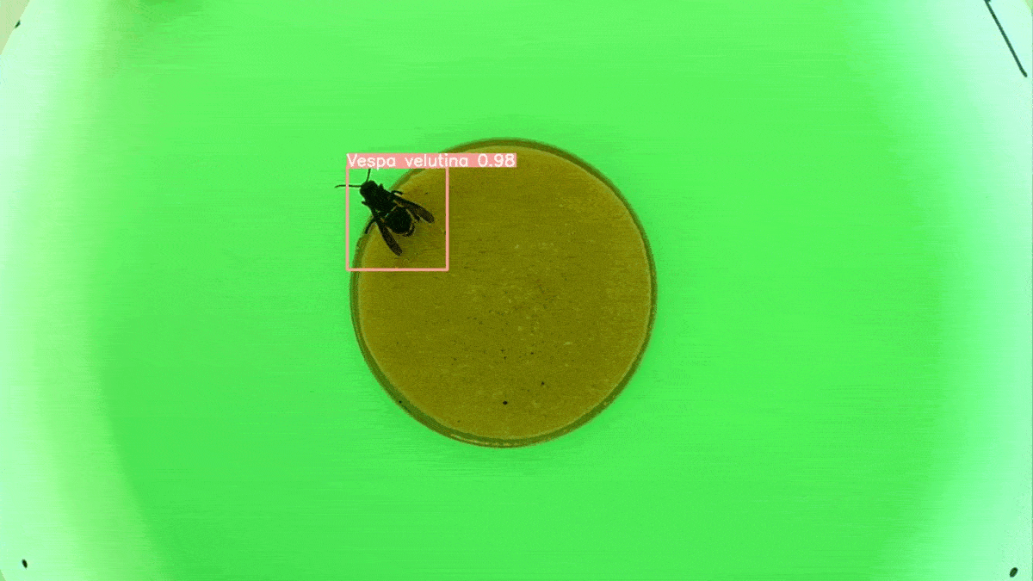

Slide 10
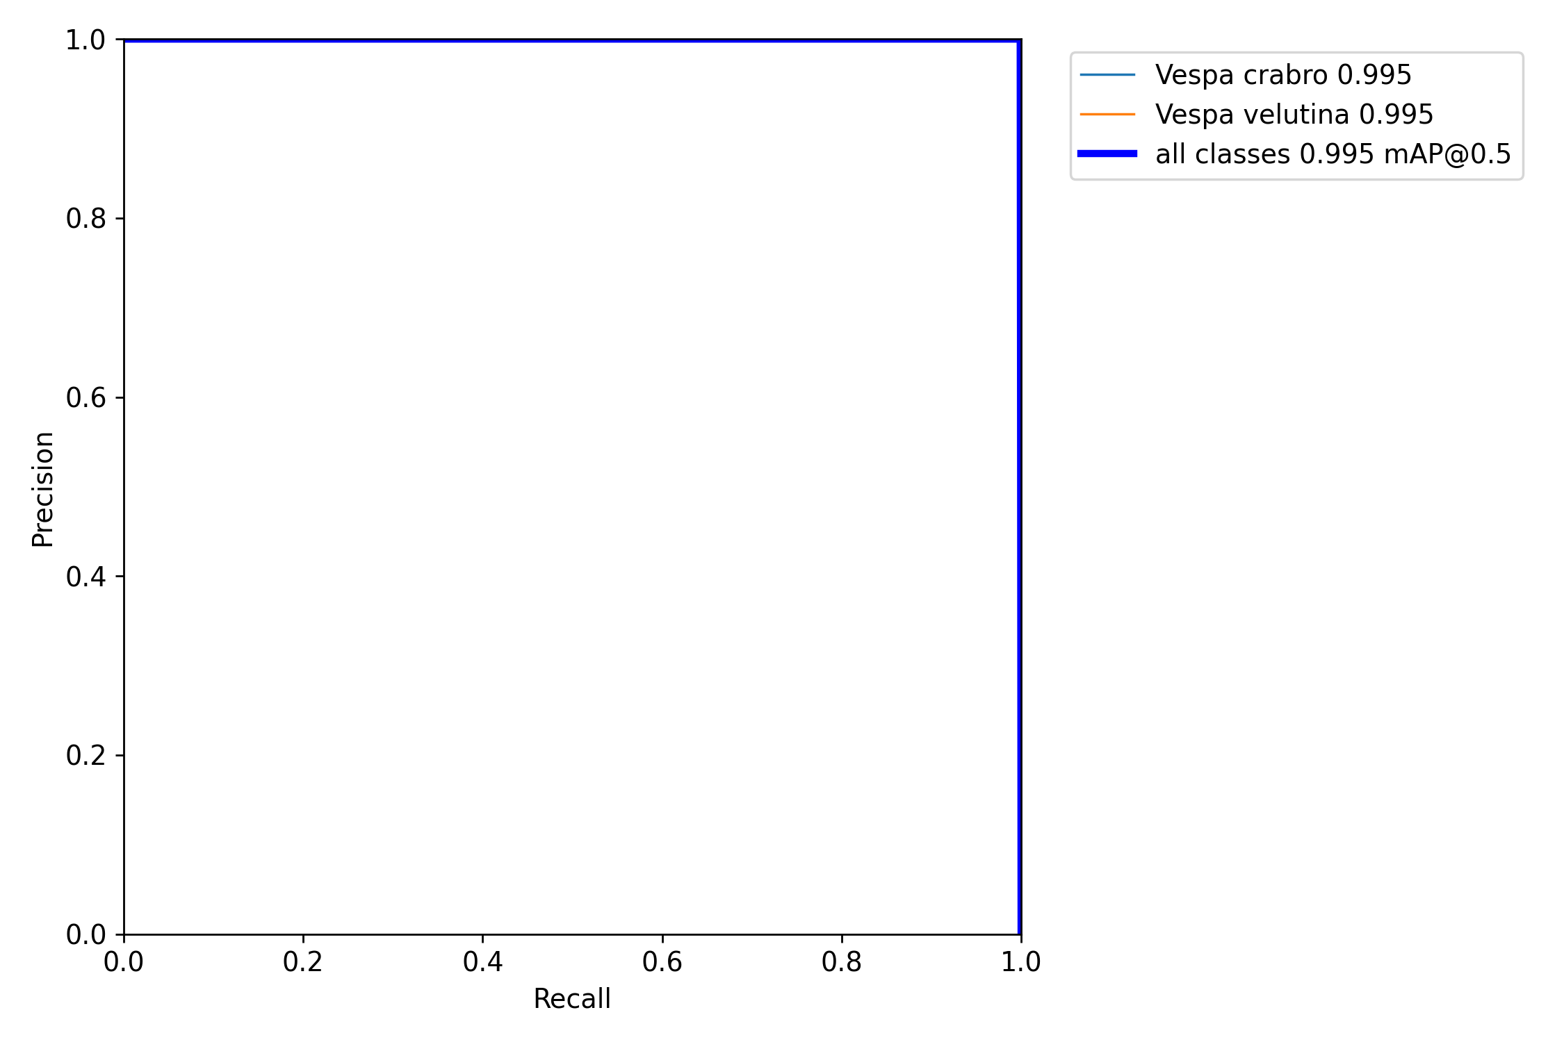
Precision-recall

Slide 11
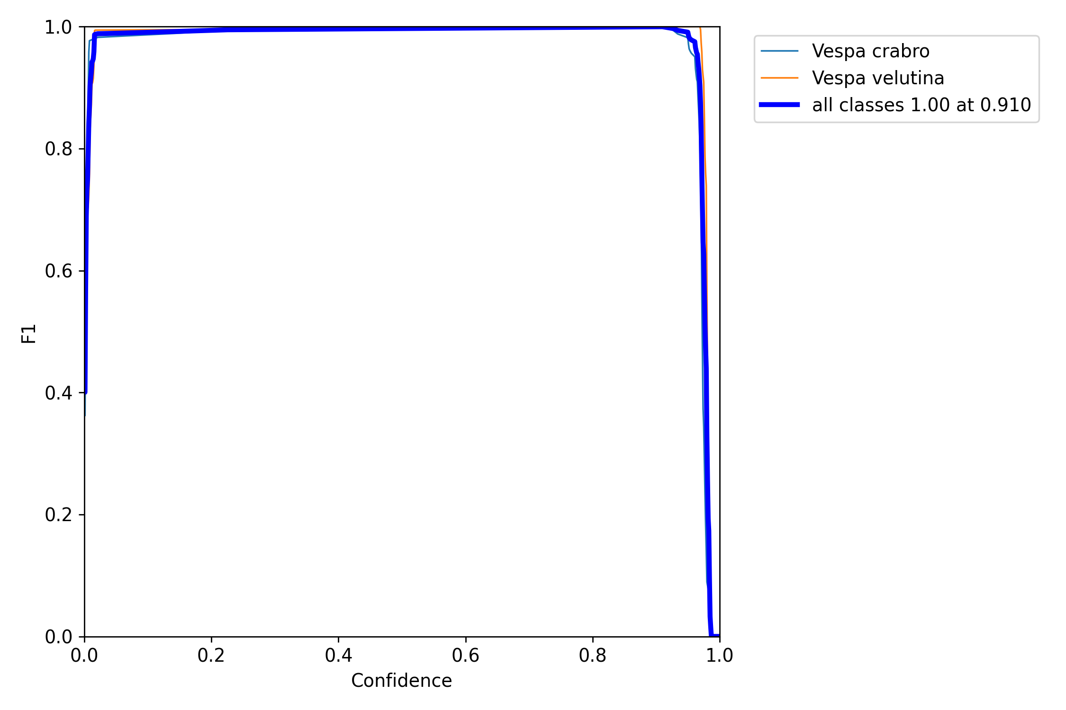
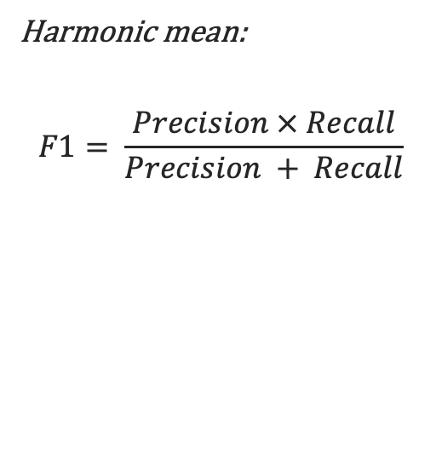
F1-curve
Harmonic mean:
$$F1= \frac{Precision × Recall}{Precision + Recall}$$

Slide 12
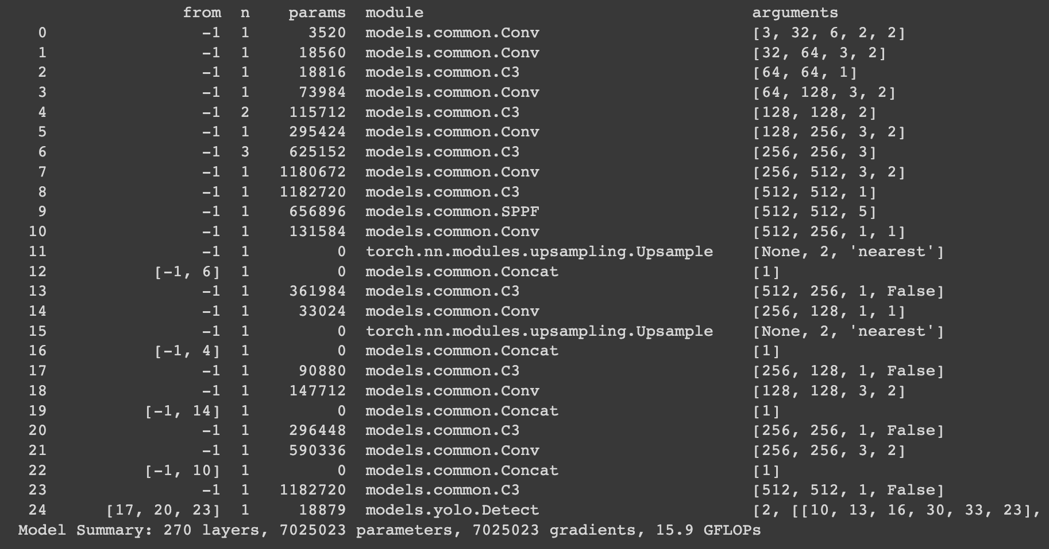
Yolo: architecture

Slide 13
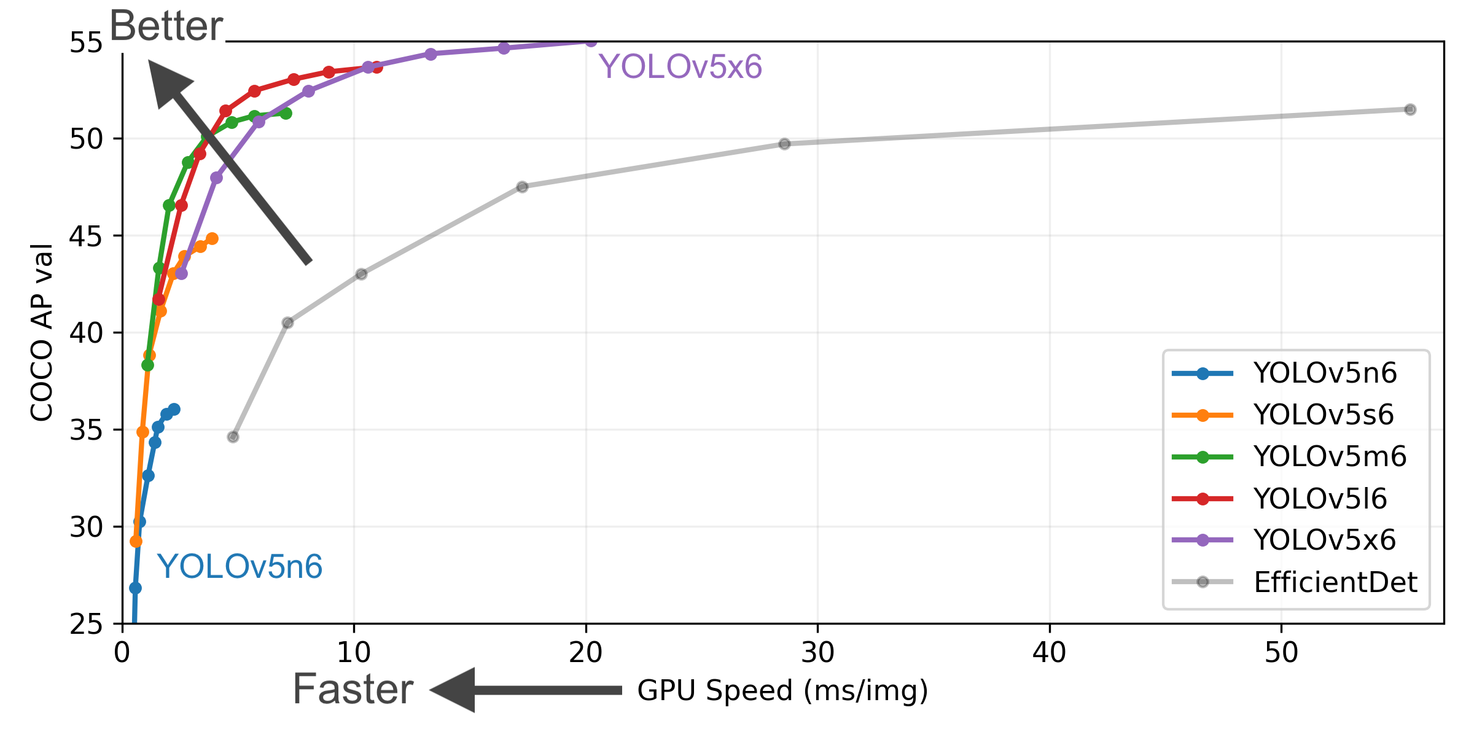
YOLO

Slide 14
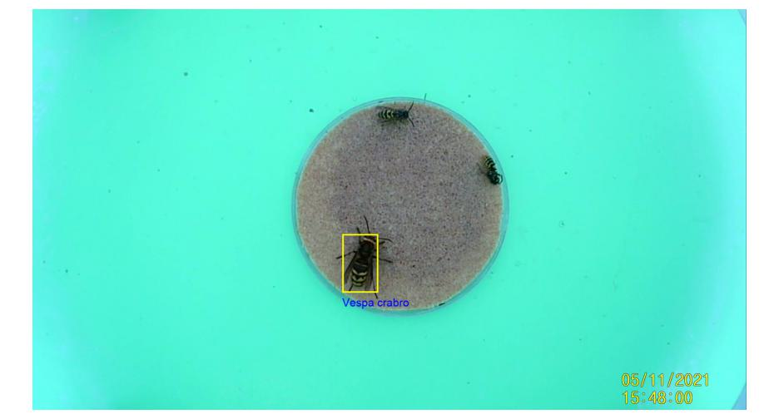

Box expansion
Top: fit-to-polygon
Bottom: 40% expansion

Slide 15
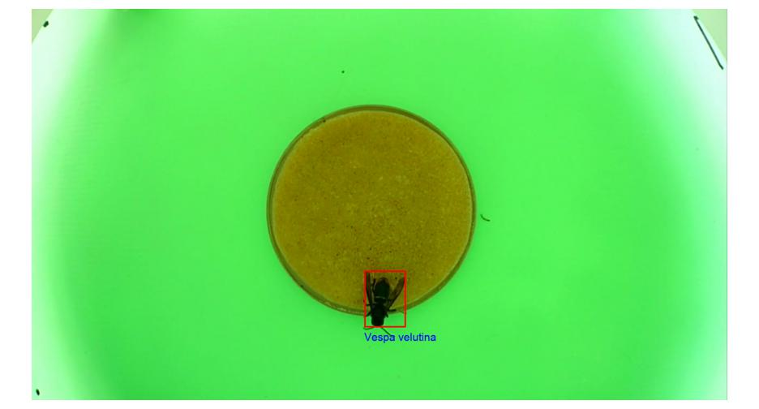
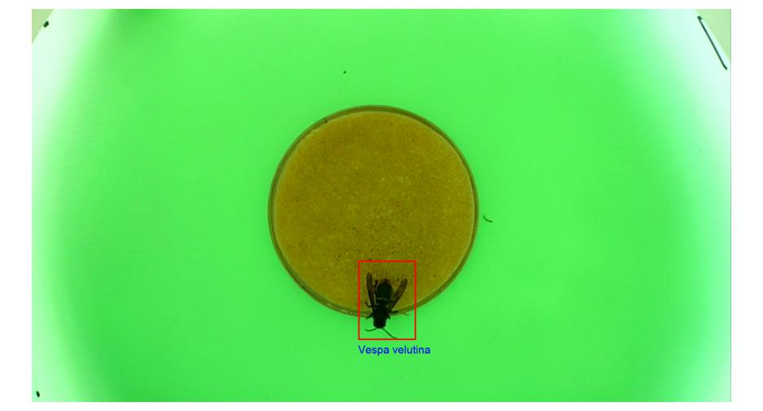
Box expansion
Top: fit-to-polygon
Bottom: 40% expansion

Slide 16
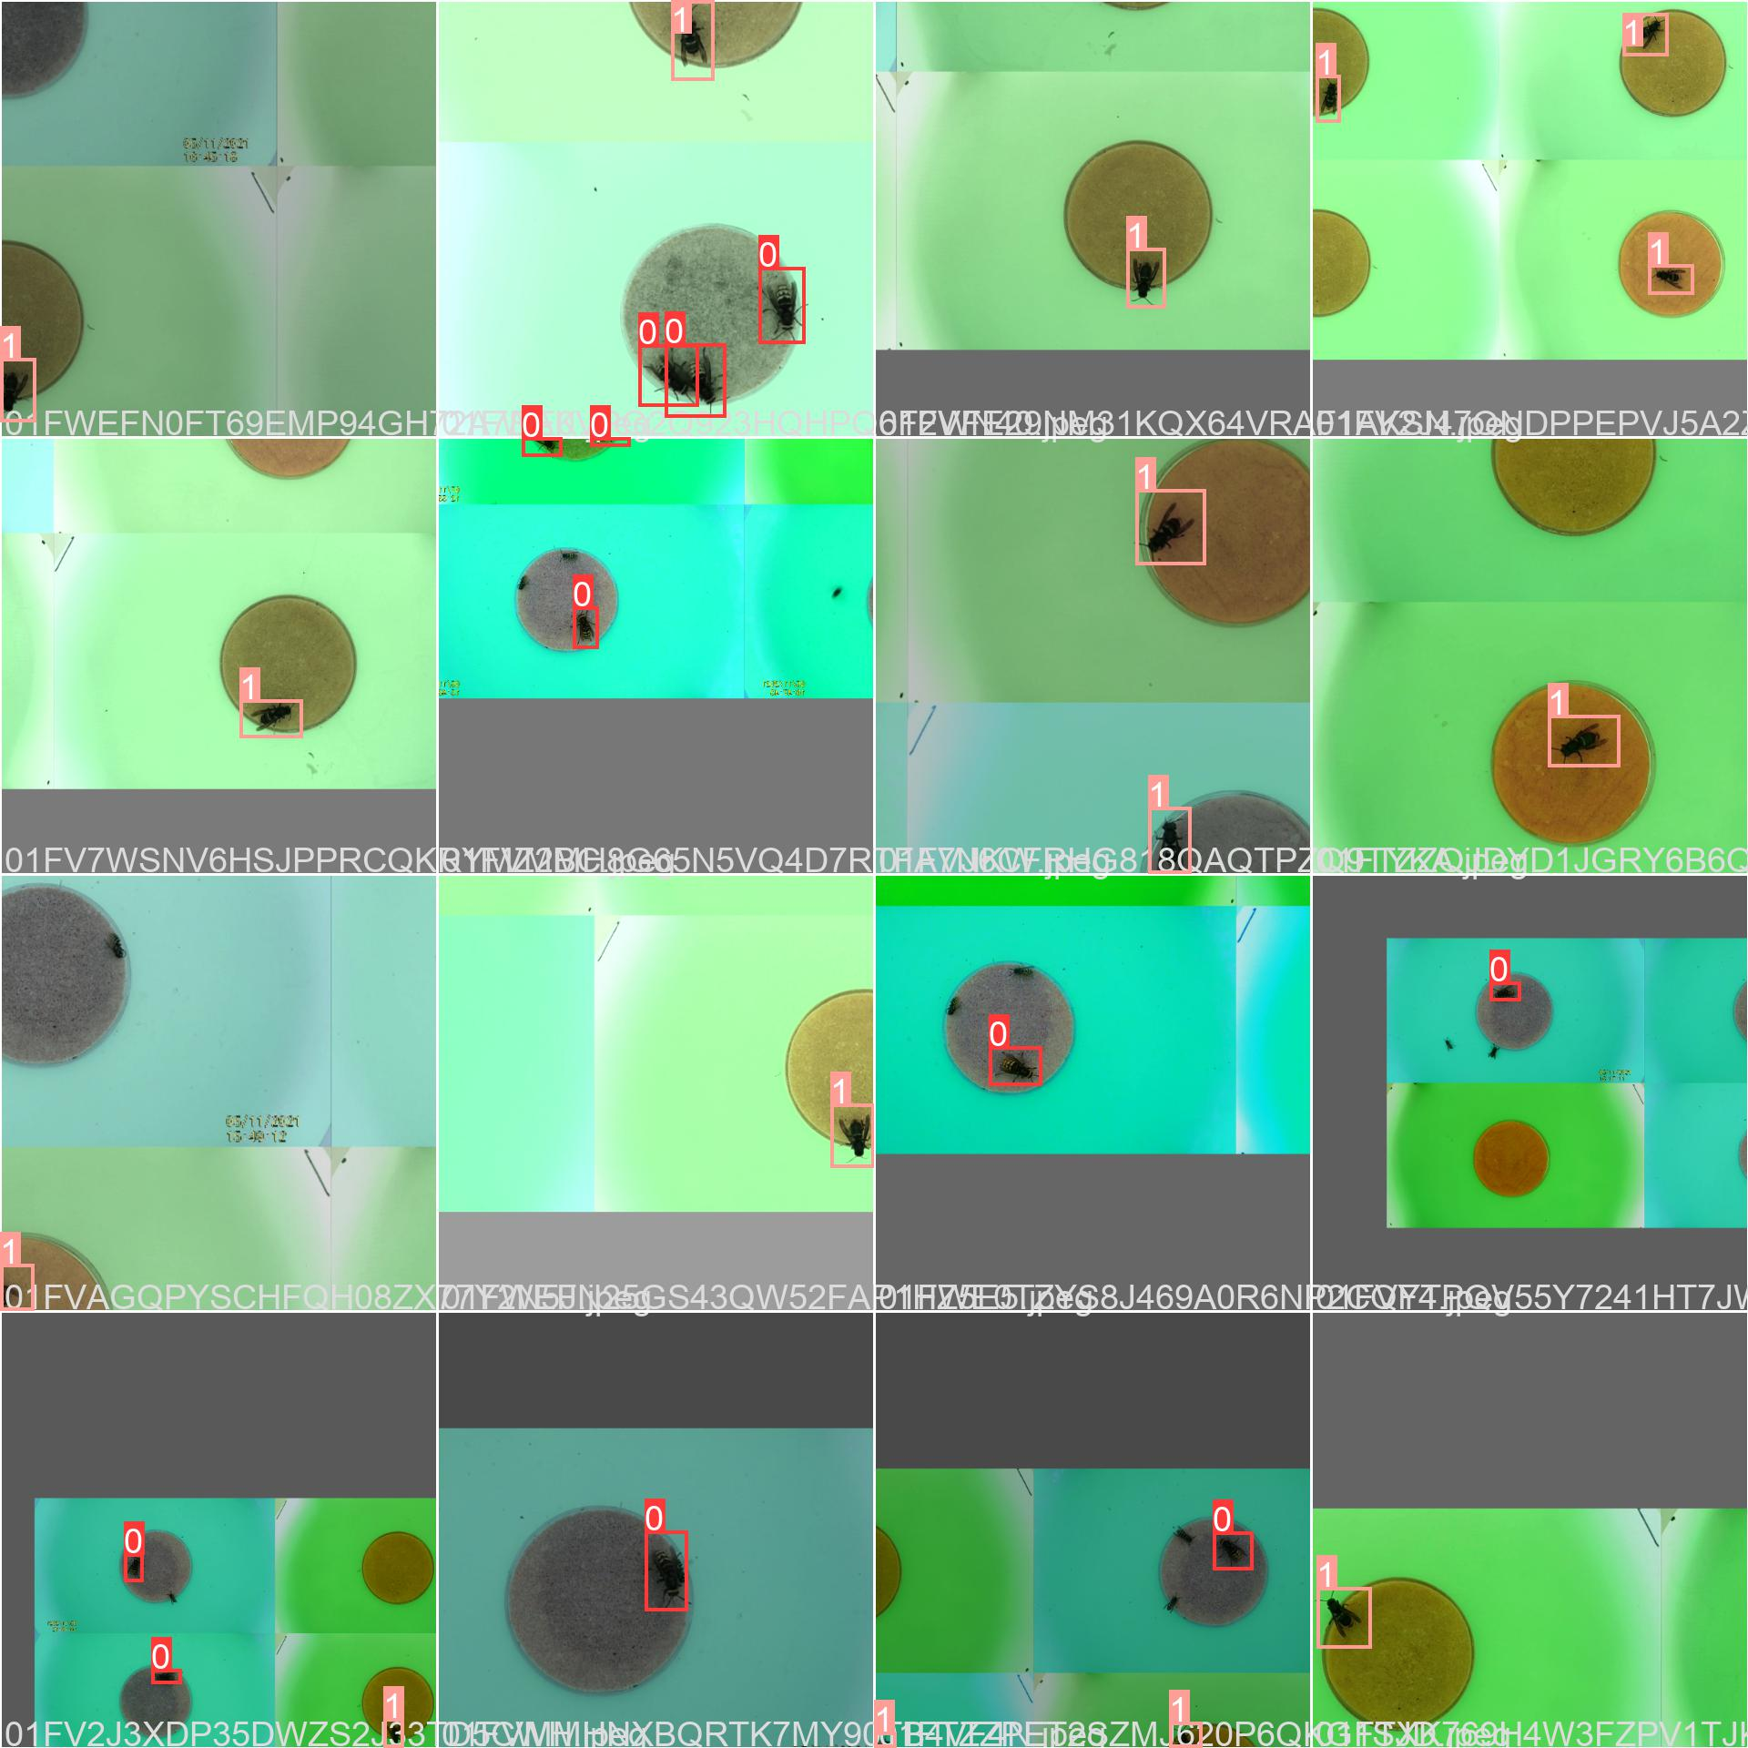
Image augmentation

Slide 17
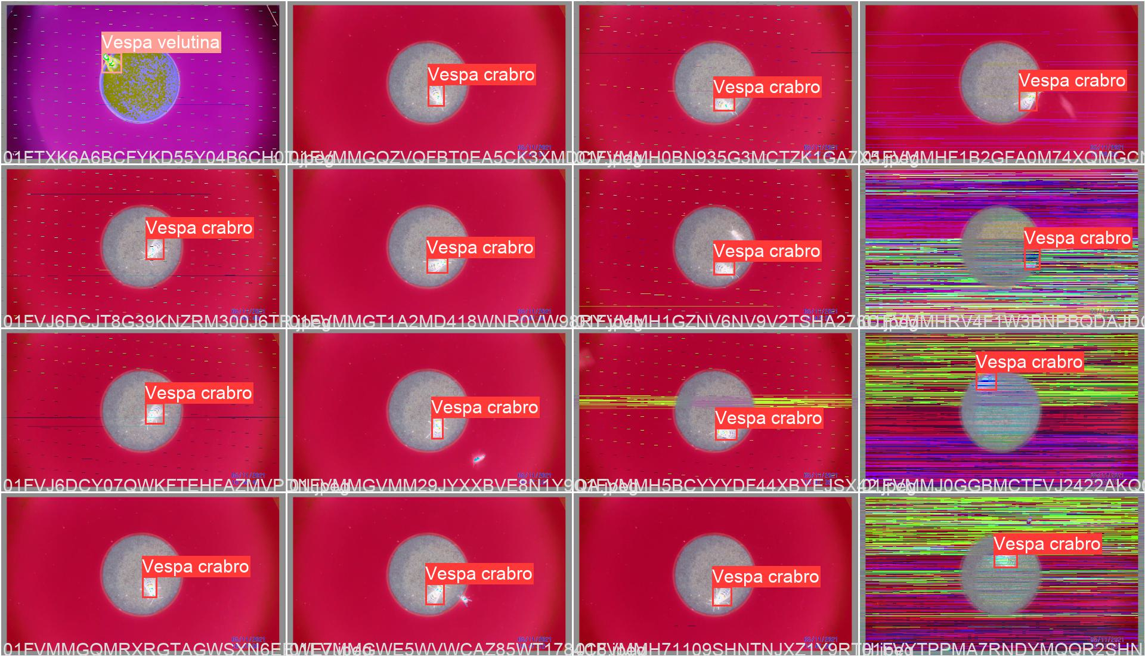

Slide 18
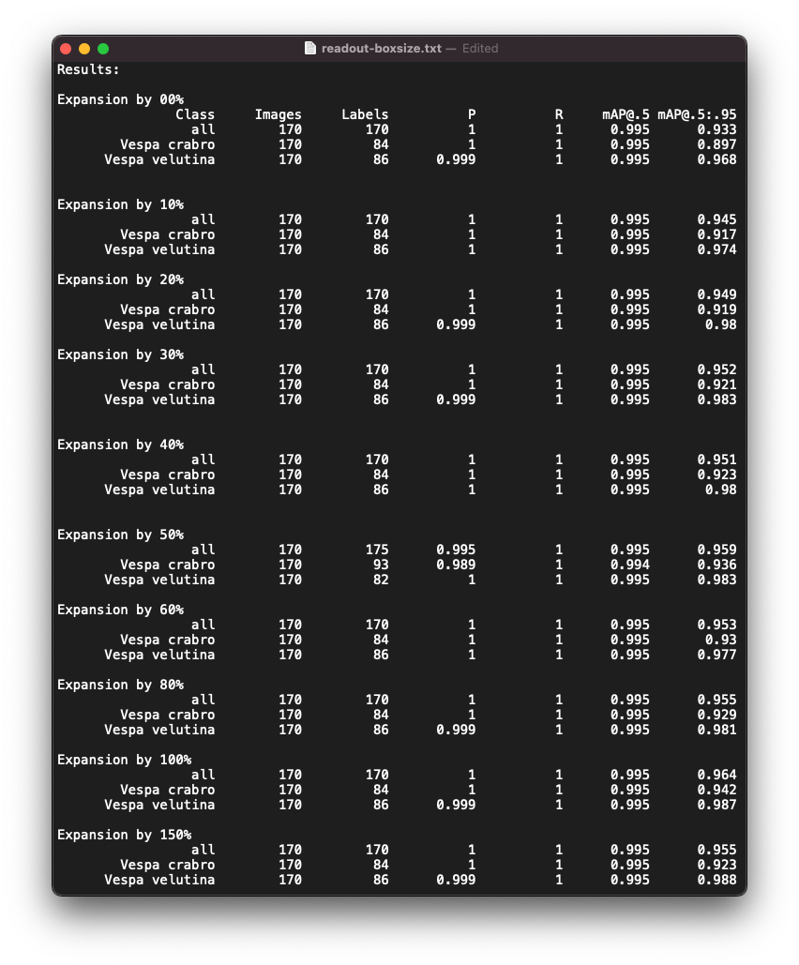
Compare box size

Slide 19
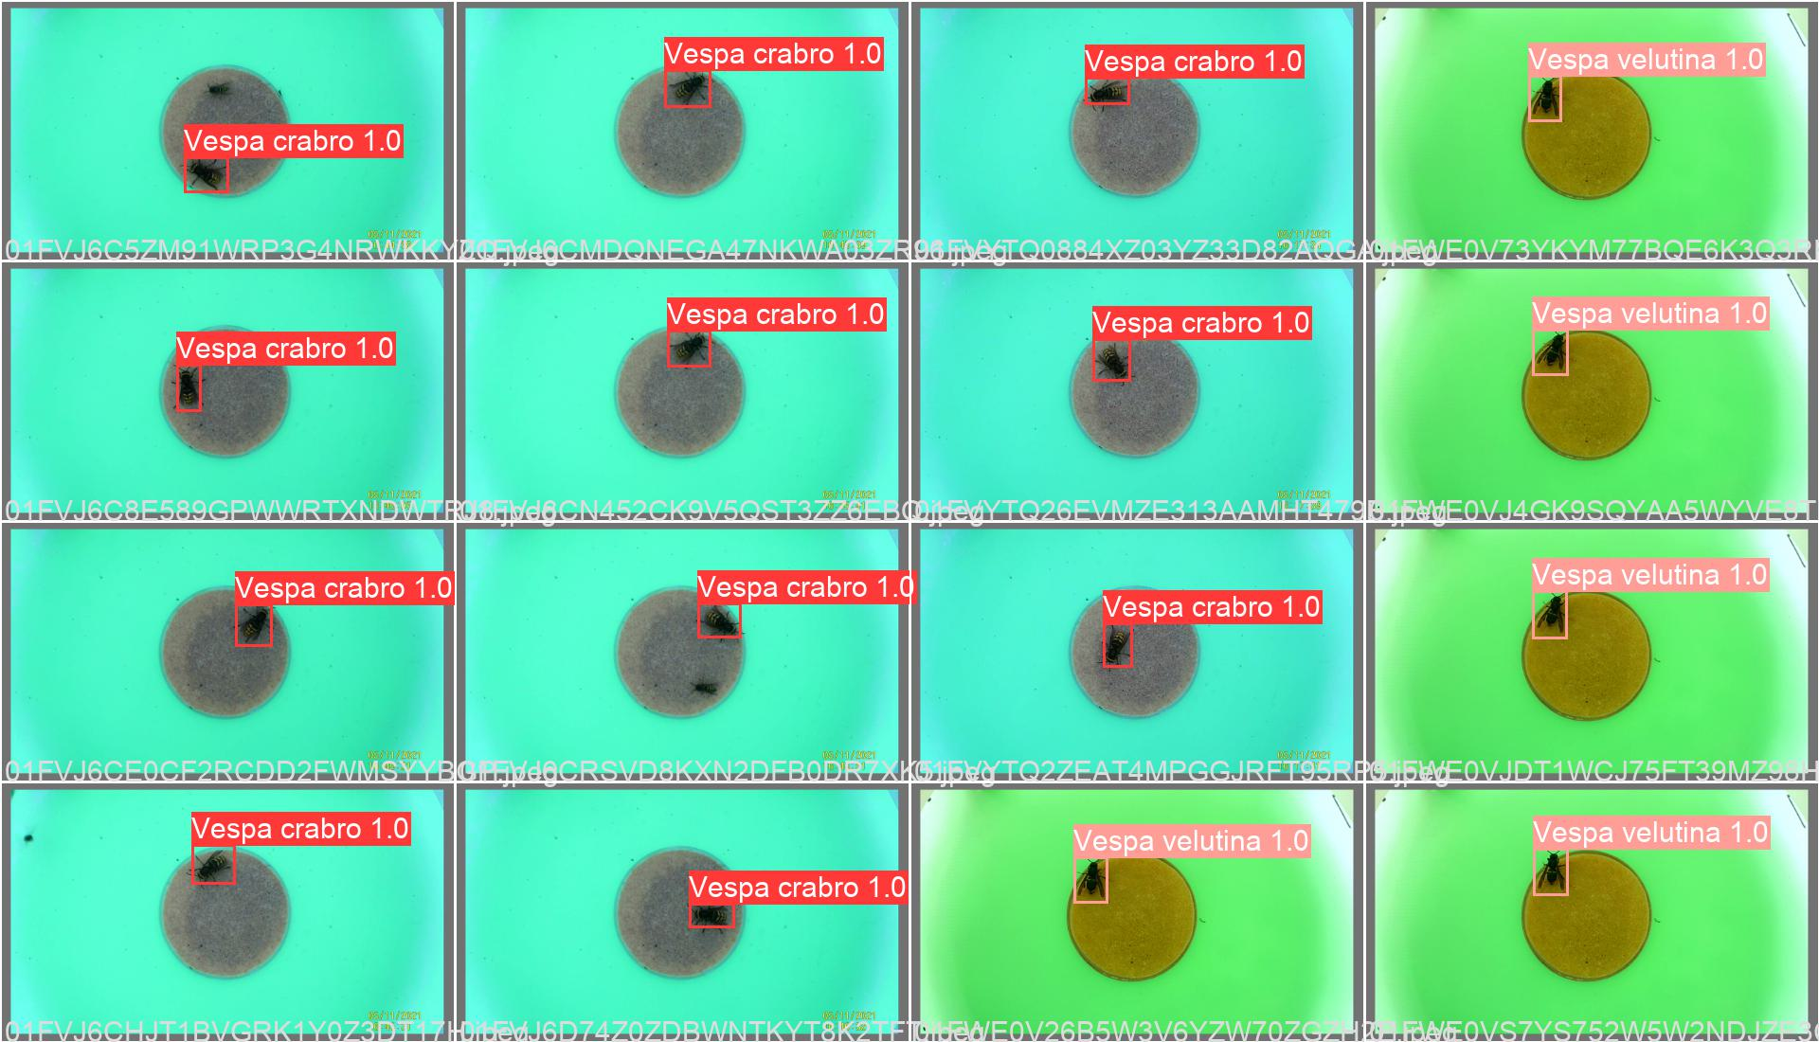
Too good to be true?
Limited hornet specimens
Background resilience
Downscaling model size
Other unknown biases

